Slide 1
Linux Signal-Based Process Controller
$ ./controller start
worker started
$ ./controller pause
Team name: Kernal_OSSP
Team No : 06
Department: CSE
Team Members :
2520030001 M.Aswitha
2520030414 N.Yishnaani
SIGSTOP sent
$ ./controller resume
SIGCONT sent
$ ./controller status

Slide 2
$ 01 problem Statement
Problem Statement and Objectives
Challenges of manual process control
Objectives
Easy process control: start, pause, resume, terminate and restart with simple commands
Status monitoring: read live process details from /proc
Signal handling: use SIGSTOP, SIGCONT and SIGTERM correctly
Activity logging: record every action in a log file
Commands like kill, ps and top need exact PIDs
Hard to tell if a process is running, stopped or finished
One wrong signal can affect the wrong process
No record of which actions were taken
Linux Signal-Based Process Controller · 2 / 7

Slide 3
Proposed Solution and System Architecture
$ 02 solution
The C controller starts a worker process, then controls it by sending signals to its PID. Status comes from /proc and every action is logged.
User
C Controller
Linux Signals
Worker Process
→
→
→
runs commands
fork, exec, kill, waitpid
SIGSTOP, SIGCONT, SIGTERM
the controlled task
/proc
Activity log
Web dashboard
Controller reads process status
Every action is recorded
Planned: HTML, CSS, JavaScript
Linux Signal-Based Process Controller · 3 / 7

Slide 4
Technologies and concepts used
$ 03 tech stack
C programming
System calls
Signals
Core controller logic
fork(), exec(), kill(), waitpid()
SIGSTOP, SIGCONT, SIGTERM
/proc filesystem
File handling
HTML, CSS, JS
Reads live process status
Writes the activity logs
Web dashboard
Linux Signal-Based Process Controller · 4 / 7

Slide 5
Key Features and Implementation
$ 04 features
Start Process
fork() and exec() launch the worker
Pause Process
SIGSTOP freezes the worker
Resume Process
SIGCONT continues the worker
Terminate Process
SIGTERM asks the worker to exit
Restart Process
Launches the worker again with a new PID
Show Process Status
Reads process details from /proc
Activity Logs
Each action is saved to a log file
Linux Signal-Based Process Controller · 5 / 7

Slide 6
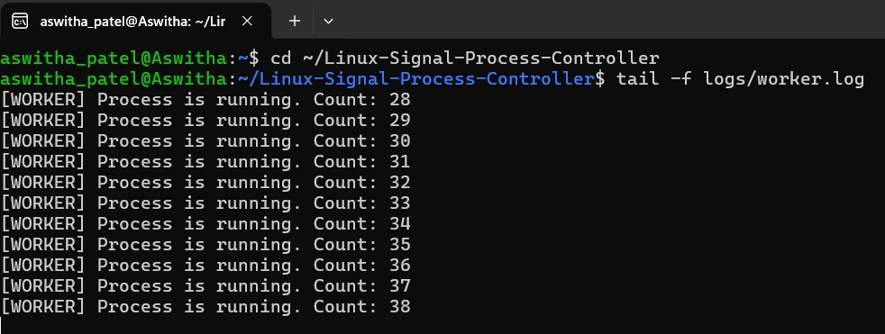
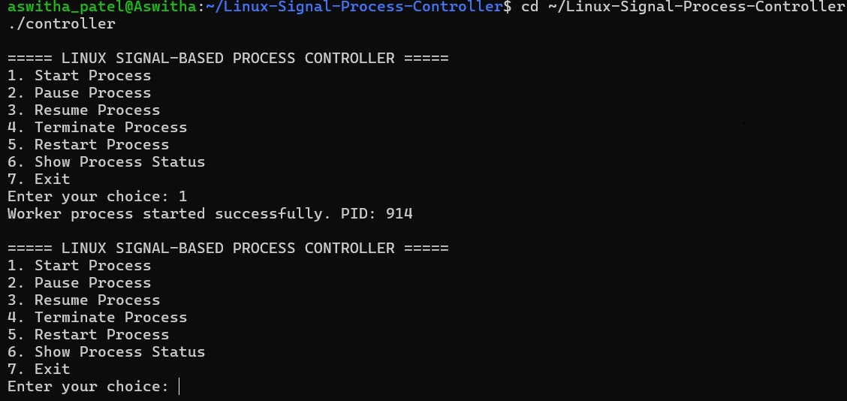
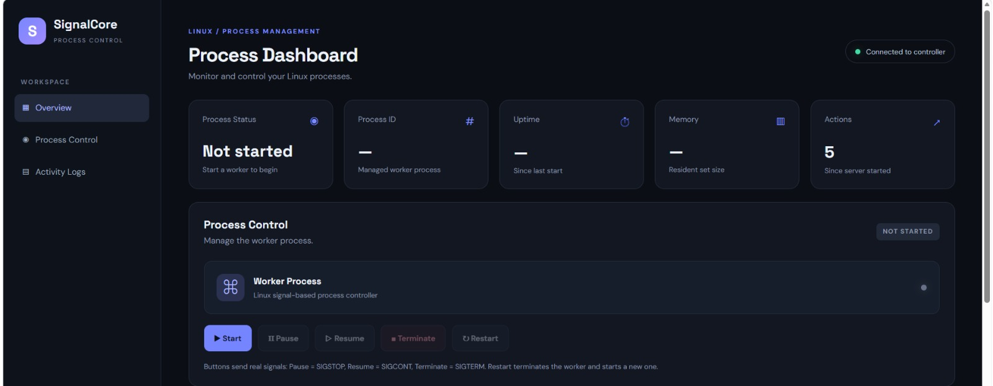
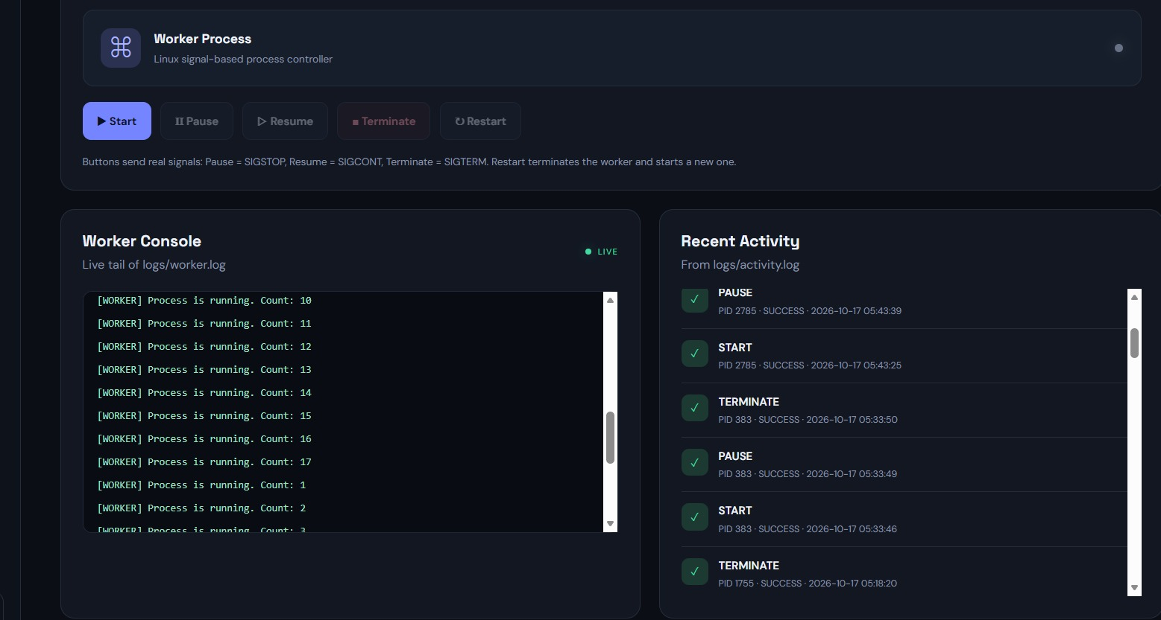
Demonstration, Testing and Results
$ 05 results
[Terminal screenshot]
[Activity log screenshot]
Verified tests
[Dashboard screenshot]
[Worker log screenshot]
Pause stops the worker counter
Resume continues the worker counter
Termination stops the worker
Restart launches a new PID
Activity logs record the operations
Linux Signal-Based Process Controller · 6 / 7

Slide 7
Conclusion and Future Enhancements
$ 06 conclusion
Conclusion
Future enhancements
Simplifies Linux process management into a few clear commands
Process control and activity logging are implemented successfully
Built with C, Linux signals and the /proc filesystem
Live dashboard integration
Multiple-process management
Resource monitoring
Improved error handling
Linux Signal-Based Process Controller · 7 / 7

